Slide 1
Mindtree’s Approach to DevOps
Accelerate your Transformation
April 2015: Enterprise Architecture, Agile Development, Immutable Infrastructure and Operations

Slide 2
Typical challenges in supporting production applications
Continuously changing applications
Iterative design of applications, allowing them to fail and fix it rapidly
Reduced release cycle based on the business needs and competitive pressures, with releases every day / weekly / bi-weekly
99.x% Application availability as a minimum hygiene
Customers demand first touch resolution
Ensuring consistent experience for globally distributed users

Slide 3

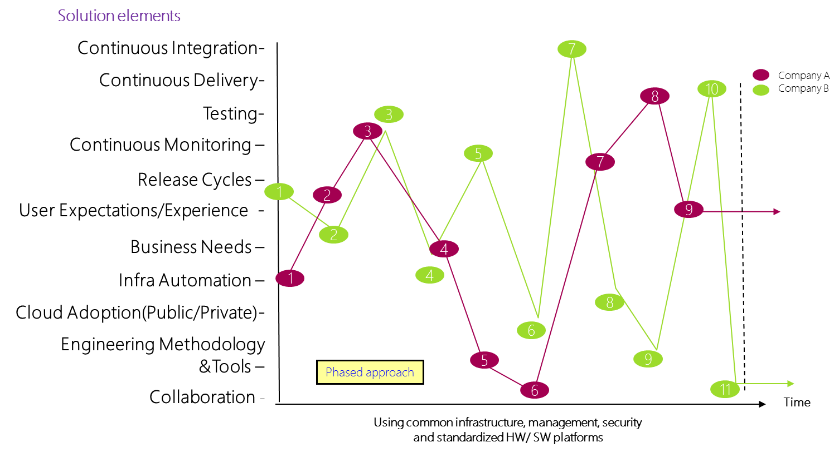
The journey is different for different organizations

Slide 4
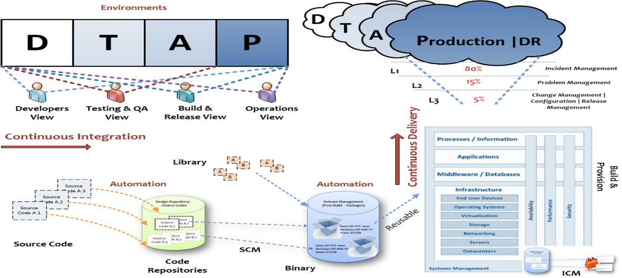
What is our perspective?
3

Slide 5
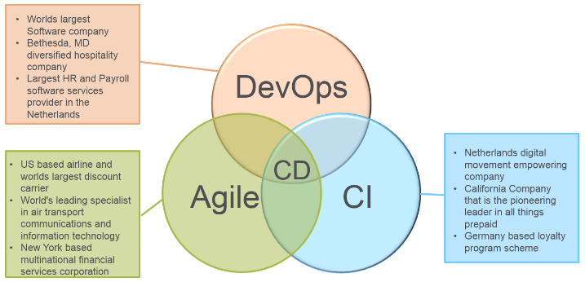
Continuous Delivery Overview
In an environment of increasing product complexity and ever-changing market and customer needs, a Continuous Delivery approach (DevOps + Agile EP + CI) can streamline development, and help improving both responsiveness and predictability in software delivery. Mindtree works with major global companies to implement continuous delivery systems.
Continuous delivery requires streamlined engineering practices at every stage of the delivery cycle and a culture focused on collaboration. Continuous Delivery is a cultural change in an organization that breaks down traditional silos and gives the entire organization complete transparency into the development lifecycle. It blends the industry leading practices in Agile Engineering Practices, Continuous Integration, and DevOps to achieve the goal of on-demand software releases. Continuous Delivery results in faster time to market, simplified code base, reduced maintenance, and an overall cost reduction of deliverables.
Mindtree architects these solutions to meet the client's needs

Slide 6
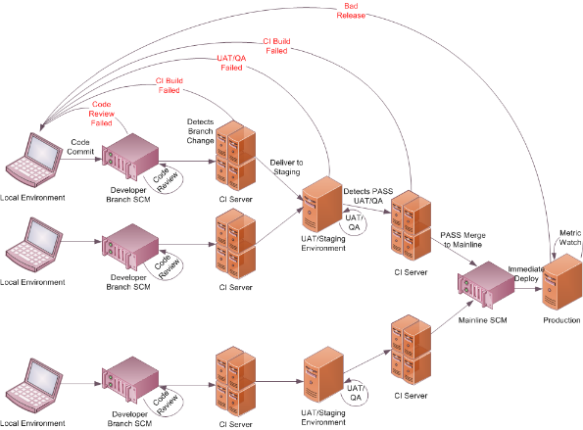
Continuous Delivery Architecture
Frequent feedback loops that fail quickly and are fixed quickly facilitate Continuous Delivery in an optimized system. This requires the merging of Agile, System Architecture, and Operations into a cohesive team that has a primary focus of delivering new features to the client.
Code is checked in multiple times a team and goes through:
A Code Quality Check
Integration Test Check
Regression Test Check
Pre-Production Test Check
Issues are routed back to the development team for correction daily maintaining low technical debt and reducing the cost of correction.
Time to market is reduced and high value working software and released to the clients frequently

Slide 7
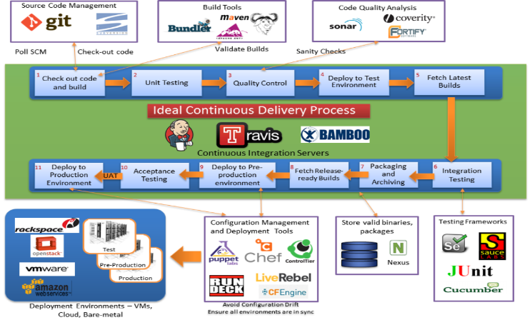
Continuous Delivery
IT Ops team see the downstream effects of Dev teams activities, and enable Dev team to anticipate issues effectively by way of continuous delivery. It is achieved through the discovery, fine-tuning and optimization of repeatable processes.
The majority of time required to deploy an application to the end-user lies not only in provisioning application or the environment, but in provisioning them in the context of the entire application delivery chain. DevOps is about how best you can integrate processes from each of the cross functional teams into a complete, application-focused operational deployment process. At Mindtree we provide meaningful and tailored integration solutions that make collaboration between people and process easier.

Slide 8
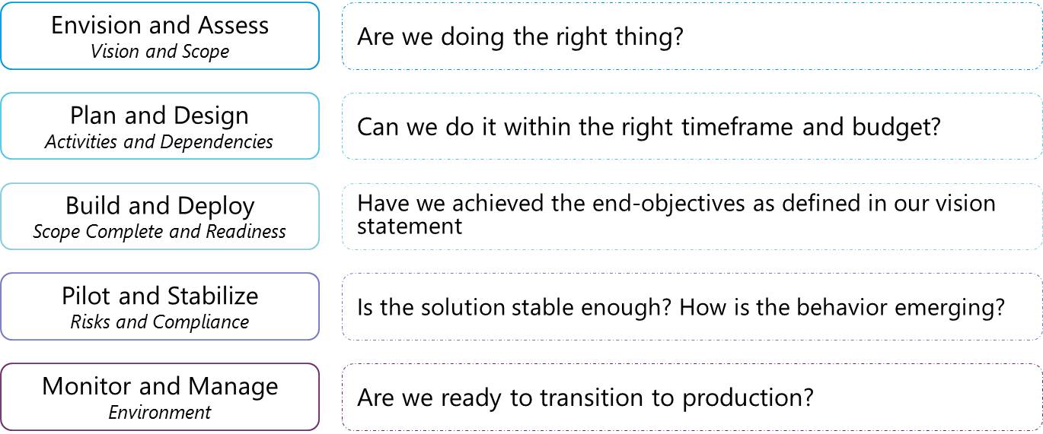
Consult and Implement: Framework Foundation

Slide 9
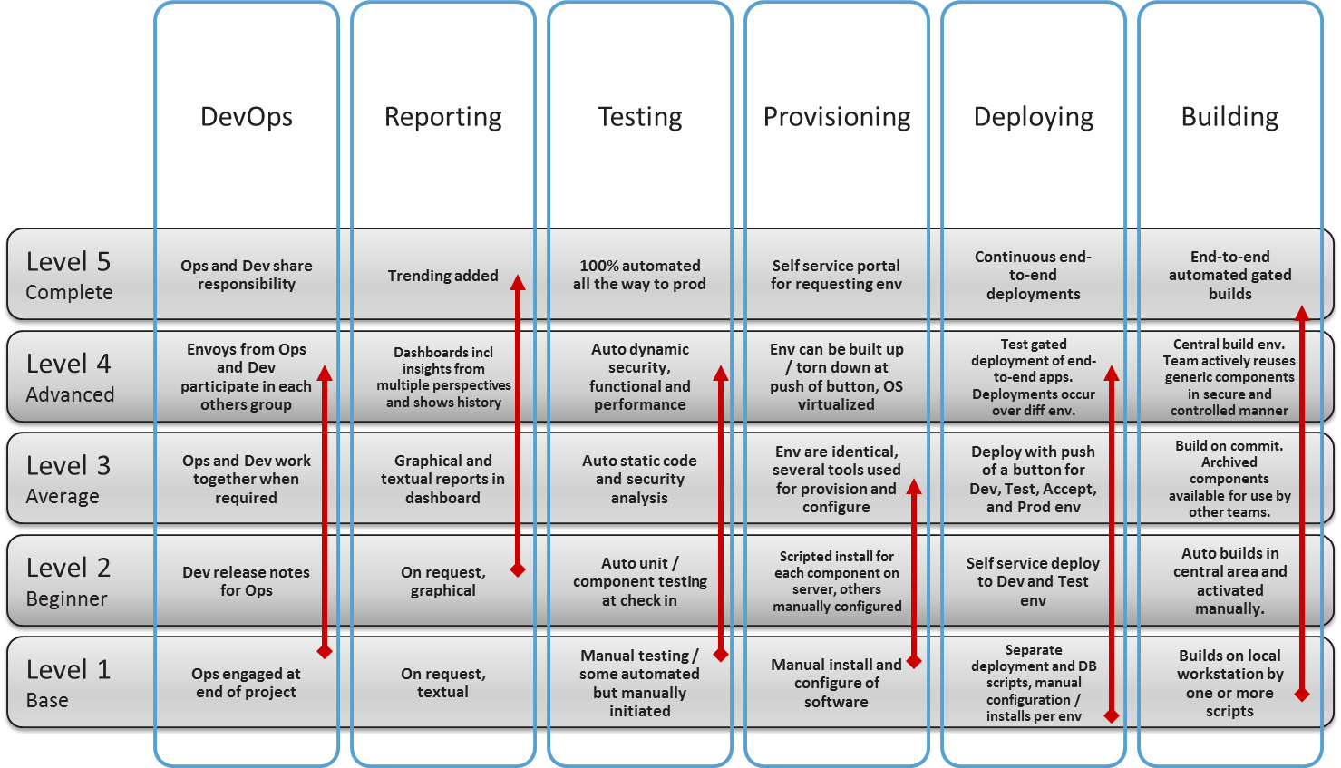
Continuous Delivery Maturity Model
Building blocks for automating the Delivery Pipeline

Slide 10
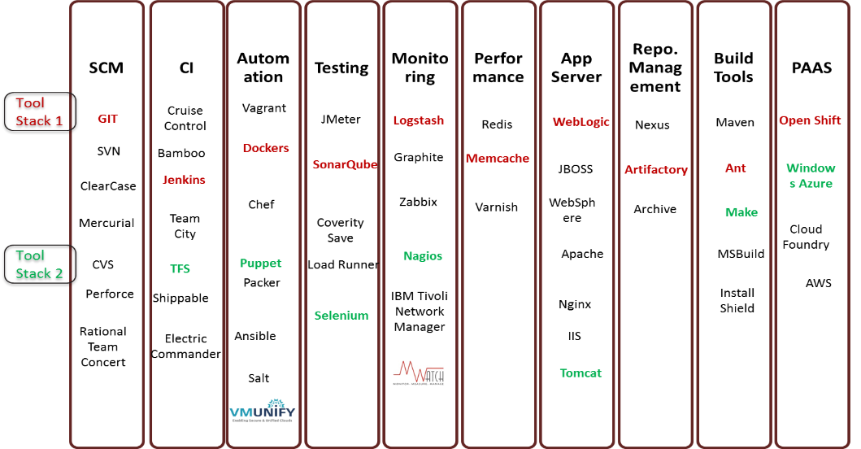
Typical DevOps Solution and Technology Tool Stack
6

Slide 12
Enterprise Architecture

Slide 13

Capability Map – Solution Architecture
Architecture & Design
Enterprise Architect / RSA
Multi-Channel enablement
WS Gateway
SMS Gateway
B2B Appliance
Security
Biometrics
Portal Server
Content Management
Search
Web analytics
Collaboration
Authentication
IDE
Eclipse / MS Visual Studio
Business Process Management
Workflow
Commerce Engine
Rule engine
Single Sign-on
Code X-Ray
Static + Dynamic profiling
Authorization
Enterprise Managed Container
Light-weight container
Access Control
Configuration Management
Integration
Messaging | Brokers | ESB | JCA
Auditing
Continuous Integration
Encryption
Build & Release Management
Database
RDBMS | No SQL
Non repudiation
Methodology -- Iterative | Agile
Testing
Unit | Functional | Integration | System | Performance | Scalability | Endurance | Security
Project Management | Program Management | Governance

Slide 14
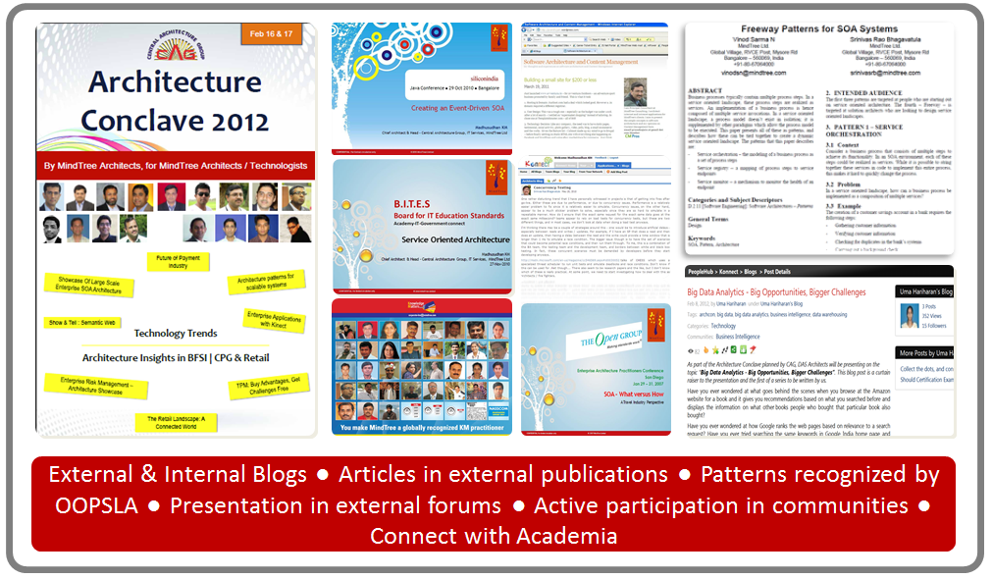

Architecture Thought-Leadership
Industry 2020
&
Architecture 2020
Retail
Travel
Insurance

Slide 15
Agile Methodology and Test Framework

Slide 16
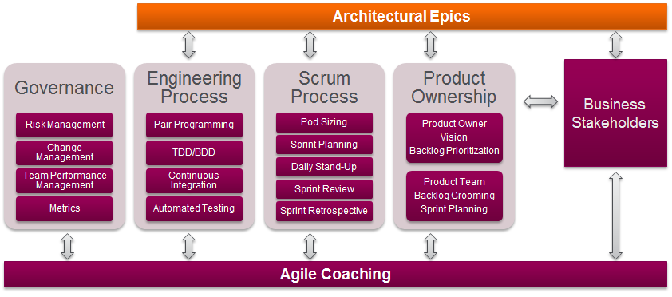
Mindtree Agile Framework
Issues in the software delivery stream, that manifest in the build phase, are often the result of decisions made in the engineering phase. Mindtree talks a holistic view and incorporates agile delivery engineering practices that support and enhance Continuous Integration and Continuous Delivery

Slide 17
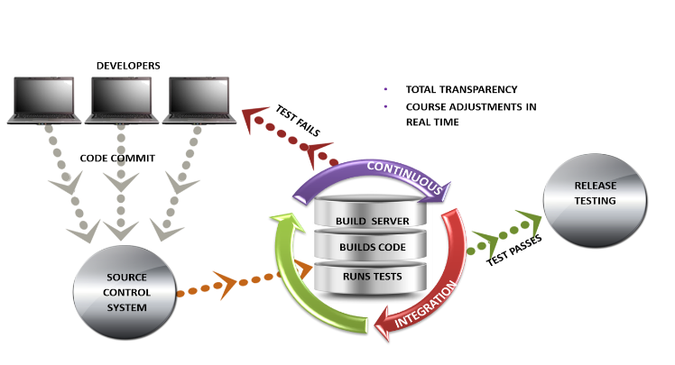
Agile Engineering Practices – Continuous Integration
Though the use of continuous integration technical debt is kept to a minimum. Throughout the day code and checked in tested and deployed. Issues are discovered and sent to the Scrum pods for resolution and working software is distributed to the Product Owner and business users for review.
When unit tests fail or a bug emerges, developers can revert the codebase to a bug-free state, without wasting time debugging
Developers detect and fix integration problems continuously — avoiding last-minute chaos at release date.
Early warning of broken / incompatible code
Early warning of conflicting changes
Immediate unit testing of all changes
Constant availability of a "current" build for testing, demo, or release purposes
Immediate feedback to developers on the quality, functionality, or system-wide impact of code they are writing
Frequent code check-in pushes developers to create modular, less complex code
Metrics generated from automated testing and CI (such as metrics for code coverage, code complexity, and features complete) focus developers on developing functional, quality code, and help develop momentum in a team

Slide 18
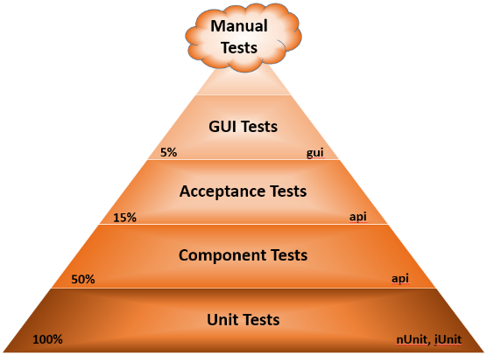
Automation Test Strategy
Mindtree focuses on test automation at the unit tests, component test and acceptance test levels. Focus will be given to create more unit tests for refactored methods which will reduce the Acceptance / Integration tests, thereby reducing the time taken for Acceptance test by 50-90%
Develop automated unit, acceptance and services (Integration) frameworks and test suites to reduce test effort
Test driven development model will be adopted
Data driven tests will be implemented to include data for multiple carriers
Automation of acceptance tests will be based on Behavior Driven Development model
Focus on code reusability to ensure modularization
Test scripts will be developed to execute across multiple browsers.
Target coverage
Unit Testing - Target 100+% of test coverage using N-Unit, Junit or similar. For unit testing, existing scripts will be analyzed and if required will be reused to bring down the cost of automation
Component testing – Target 50% test coverage of services using SOAPUI or similar. If existing component tests are available and there are minor changes to the components, then Mindtree will leverage the existing scripts. For new components, new scripts will be developed.
Acceptance testing – Target at least 15% of test coverage SpecFlow, Selenium or similar
GUI Testing – Target of at least 5% of test coverage

Slide 19
More about DevOps

Slide 20
Mindtree’s “Dev Ops” University
Coding, Testing &Validation
Finishing School Talent
Testing & Infrastructure
Lateral
Dev.
Talent
Build and Release
Monitoring, Instrumentation, self-healing and infrastructure operations
Lateral
Ops Talent
C#, .NET, IIS , SQL Server Power shell, WCF
Center of Dev-Ops Excellence
Faculty & OJT trainings
Cross Training
Embedding Dev, Test, Ops mindset
Domain specific training
Certified
Dev-Ops Engineers
Certify

Slide 21
How our DevOps methodology resulted in value creation for the worlds largest public PaaS service provider
Influenced 30% of incremental platform releases with operational insights
Support in delivering 99.95% Service availability
Deliver “non-linearity” and near 100% service availability

Slide 22
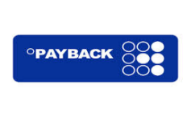





Our experience
10

Slide 23
Value Delivered : Build highly scalable next generation CI/CD Solutions to bring innovative solutions
Manual process – Time and Cost
Automation
Environment provisioning reduced from 7 to 1 Day
Deployment Time reduced from 2 hours to 10 mins
Slower Release & Testing Cycles
Dependency on multiple integration
points added to effort and
productivity loss
More time for innovation
Defect leakage reduced by 36%, Saving effort & cost
Increased Quality
A
CI and CD Automation
Faster Time to Market
Zero Downtime with minimal impact on end customer
B
Before
After
** Realized benefits vary depending on the environment

Slide 24


